Slide 1

Probability Theory

Slide 2
Learning Objectives
By the end of this session, you will be able to:
Define probability, sample space, and events.
Understand key properties of probability.
Calculate probabilities for dice, coins, and cards with step-by-step solutions.

Slide 3

What is Probability?
Probability is a mathematical measure that quantifies the likelihood that an event will occur.
Range: 0 to 1.

Slide 4
Basic Probability Concepts
Probability – the chance that an uncertain event will occur (always between 0 and 1)
Impossible Event – an event that has no chance of occurring (probability = 0)
Certain Event – an event that is sure to occur (probability = 1)

Slide 5

Question: What is the probability of rolling a number greater than 4 on a fair six-sided die?

Slide 6
Problem: What is the probability of rolling a number greater than 4 on a fair six-sided die?
Solution: A six-sided die has six possible outcomes: 1, 2, 3, 4, 5, and 6. The favorable outcomes for rolling a number greater than 4 are 5 and 6.
Number of favorable outcomes: 2 (which are 5 and 6)
Total number of outcomes: 6
Answer: The probability of rolling a number greater than 4 is 2/6 = 1/3

Slide 7
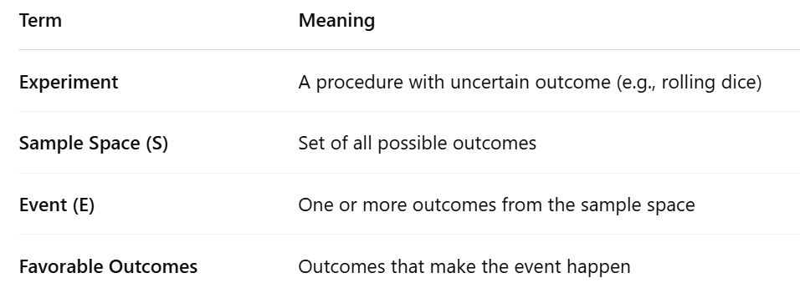
Key Terms in Probability

Slide 8
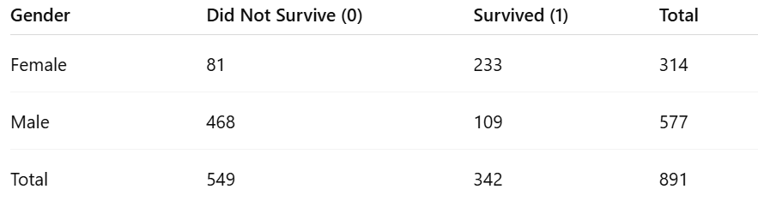
Reference Dataset
‘titanic’ dataset crosstab

Slide 9
Simple Calculations
Find out the following probabilities:
1. Probability that a passenger is female (P(Female)).
2. Probability that a passenger is male (P(Male))
3. Probability that a passenger survived (P(Survived))
4. Probability that a passenger is female and survived (P(Female ∩ Survived))

Slide 10
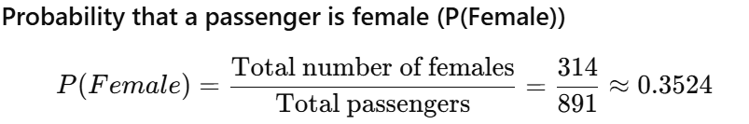
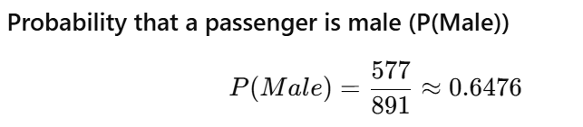

Slide 11



Slide 12
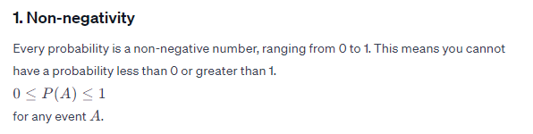
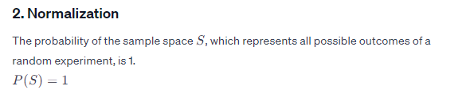
Properties of Probability

Slide 13
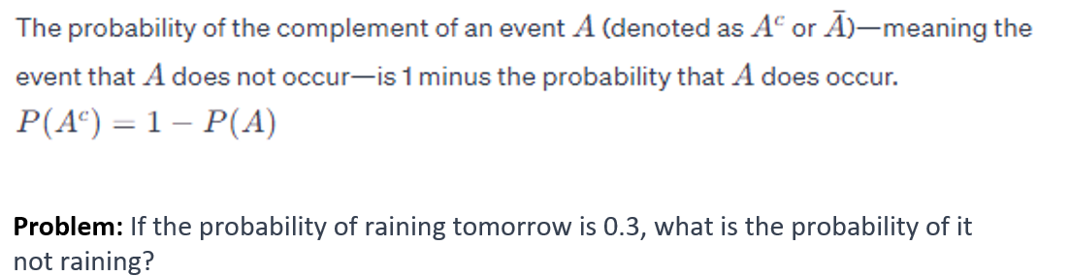
Complement Rule

Slide 14
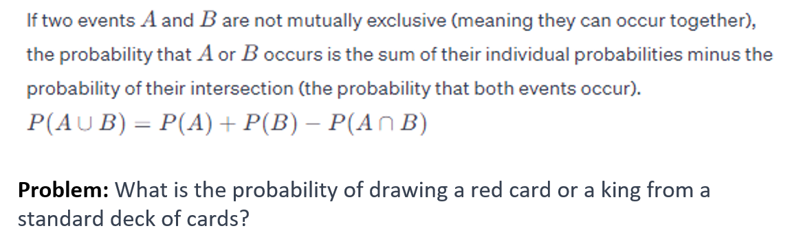
Addition Rule

Slide 15
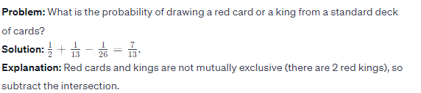

Slide 16
Probability that a passenger is female or survived (P(Female ∪ Survived))

Slide 17
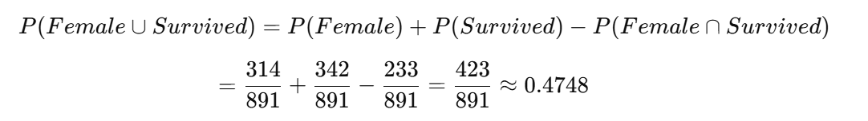
Probability that a passenger is female or survived (P(Female ∪ Survived))

Slide 18
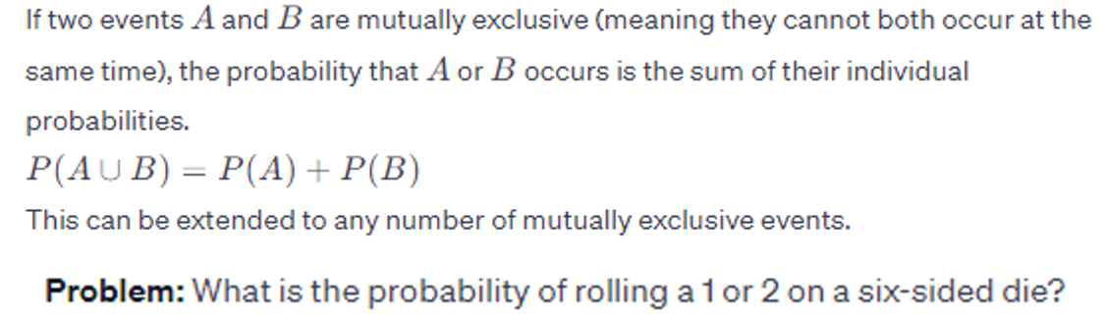
Addition Rule for Mutually Exclusive Events

Slide 19
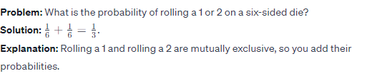

Slide 20
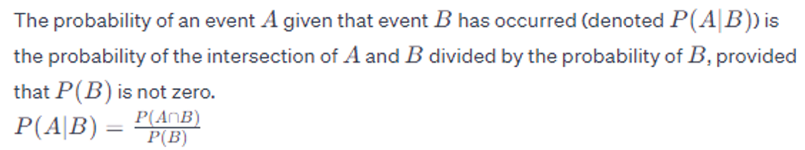
Conditional Probability
Probability that a passenger survived given that they are female (P(Survived | Female))

Slide 21
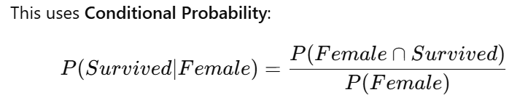
Conditional Probability
Probability that a passenger survived given that they are female (P(Survived | Female))

Slide 22

Conditional Probability

Slide 23
Conditional Probability
Probability that a passenger survived given that they are male (P(Male | Female))

Slide 24

Conditional Probability
Probability that a passenger survived given that they are male (P(Male | Female))

Slide 25
Baye’s Theorem
Bayes’ Theorem is a way to update our beliefs about the probability of an event based on new evidence.
In simple terms:
It tells us how likely something is, given that we already know something else has happened.

Slide 26
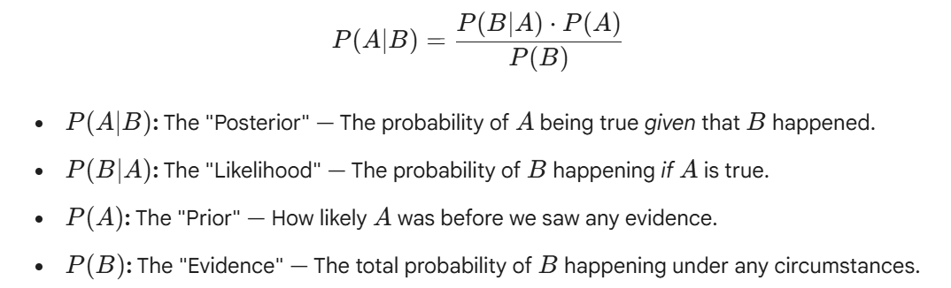
Baye’s theorem
Formula of Bayes’ Theorem

Slide 27
Baye’s theorem
The Scenario: Imagine you have two cookie jars:
Jar 1: 30 chocolate chip cookies and 10 plain cookies.
Jar 2: 20 chocolate chip cookies and 20 plain cookies.
You pick a jar at random (50/50 chance) and blindly pull out a cookie. It's a chocolate chip cookie.
What is the probability that it came from Jar 1?

Slide 28
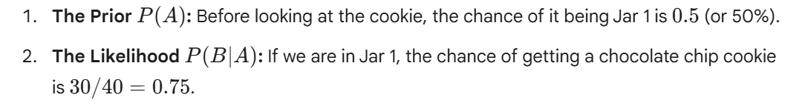
Step by step solution

Slide 29
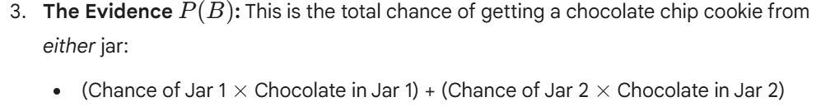
Step by step solution

Slide 30
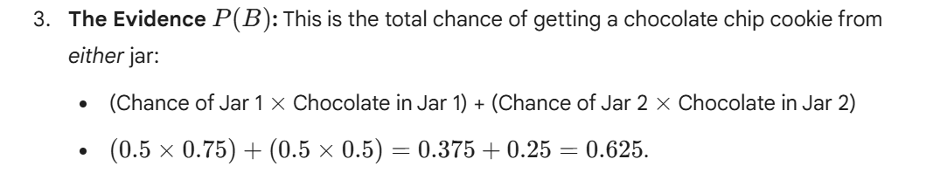
Step by step solution

Slide 31
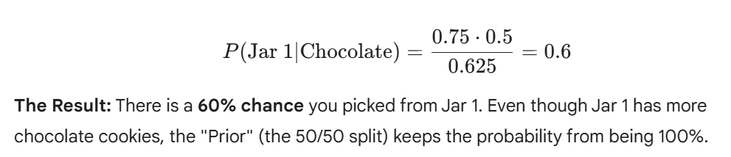
Step by step solution

Slide 32
Simple explanation
Use this three-step logic:
Start with what you knew: I have a 50/50 shot of picking Jar 1.
See the evidence: I just pulled a chocolate cookie. Jar 1 has more of those than Jar 2.
Update the belief: Since Jar 1 is 'better' at producing chocolate cookies, my 50% confidence should go up. Bayes tells us exactly how much it goes up (to 60%).

Slide 33
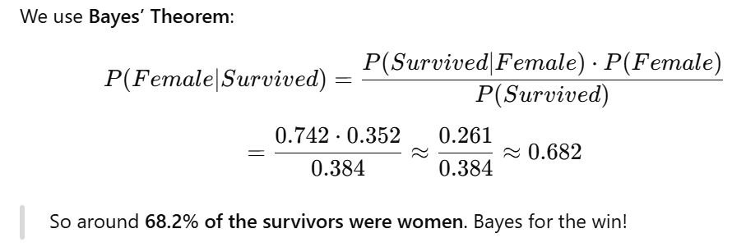

Baye’s theorem example
What’s the probability a survivor was female?
That’s $P\left(Female∣Survived\right)$

Slide 34
Difference
Feature | Conditional Probability | Bayes’ Theorem
Definition | Probability of A given B | Updates probability of A after B is observed
Purpose | Direct computation | Reversing or updating beliefs
Focus | Descriptive | Inference / learning from data
Use Case | "If it’s raining, what’s the chance the ground is wet?" | "The ground is wet — what’s the chance it rained?"

Slide 35
Multiple Choice Questions (MCQs)
Q1: If events A and B are independent, P(A ∩ B) is: A) P(A) + P(B) B) P(A) – P(B) C) P(A) × P(B) D) None of the above
Q2: What is the sample space for a coin toss? A) {H, T} B) {1, 2} C) {Red, Black}

Slide 36
Multiple Choice Questions (MCQs)
Q1: If events A and B are independent, P(A ∩ B) is: A) P(A) + P(B) B) P(A) – P(B) C) P(A) × P(B) ✅ D) None of the above
Q2: What is the sample space for a coin toss? A) {H, T} B) {1, 2} C) {Red, Black} Answer: A) {H, T}

Slide 37
Session Summary
In this session, we have discussed about:
Define probability, sample space, and events.
Understand key properties of probability.
Calculate probabilities for dice, coins, and cards with step-by-step solutions.

Slide 38
Reference Links
10 Must-Know Probability Concepts for Every Aspiring Statistician and Data Scientist
Mastering Credit Risk Analysis: A Step-by-Step Guide to Descriptive Statistics in Python
10 Statistical Concepts Every Aspiring Data Scientist Should Know — The Davangers’ Guide!
Top 20 Interview Questions on Descriptive and Inferential Statistics
10 Must-Know Statistics Interview Questions (With Real Examples & Formulas!)

Slide 39

THANK YOU
For any Query:
Website- www.onlinecu.in
Helpline no.: 1800 121 388 800

